Slide 1
Sudoku Solver Analysis
Super Unsupervised Learners
Nav Sanya Anand, Kamarin San Nicolas, Clay Freitas, Ryan Perez, Enrique Verduzco
Notes:
Greet! Introduce everyone...Introduce the project
Good afternoon everyone I’m Enrique and our team, the Super Unsupervised Learners, consisting of:
Nav, Kammy, Clay, and Ryan is going to go over our project Sudoku Solver Analysis today.

Slide 2
Motivation
The golden rule of solving Sudoku by hand is to never guess and backtracking does a lot of guessing which makes it impossible to solve (by hand/brain).
Evolutionary algorithms and simulated annealing uses trial and error methods to solve a sudoku puzzle. It is very fascinating to see each process against a simple satisfiability problem which solves from simple constraints.
Notes:
Our motivation for this project came from the way the human brain solves a sudoku puzzle. Humans solve these puzzles by following the simple constraints of Sudoku where through these constraints it is nearly impossible to for a human to solve it through random back tracking due to the total amount of possible combination in the puzzle.
So both evolutionary algorithms and simulated annealing use trial and error to solve any given sudoku puzzle. We wanted to see each of these strategies against satisfiability which solves the puzzle via simple constraints

Slide 3
Project Pitch
Solution and analysis for a 9x9 sudoku game through 3 strategies.
Satisfiability
Simulated Annealing
Evolutionary Algorithm
Notes:
So for our project we found and analyzed the solutions of 30 unique 9x9 sudoku game through 3 different strategies.
These 3 strategies are satisfiability, simulated annealing, and evolutionary algorithm.

Slide 4
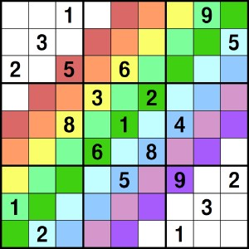
Introducing Sudoku
Notes:
So for the uninformed let me give a brief background on Sudoku.
Sudoku consists of A grid of 9 boxes where each of those 9 boxes contains another 9 boxes.
Sudoku follows a set of rules to find the unique solution for any given puzzle that you’ll hear about in a moment right now from Nav.

Slide 5
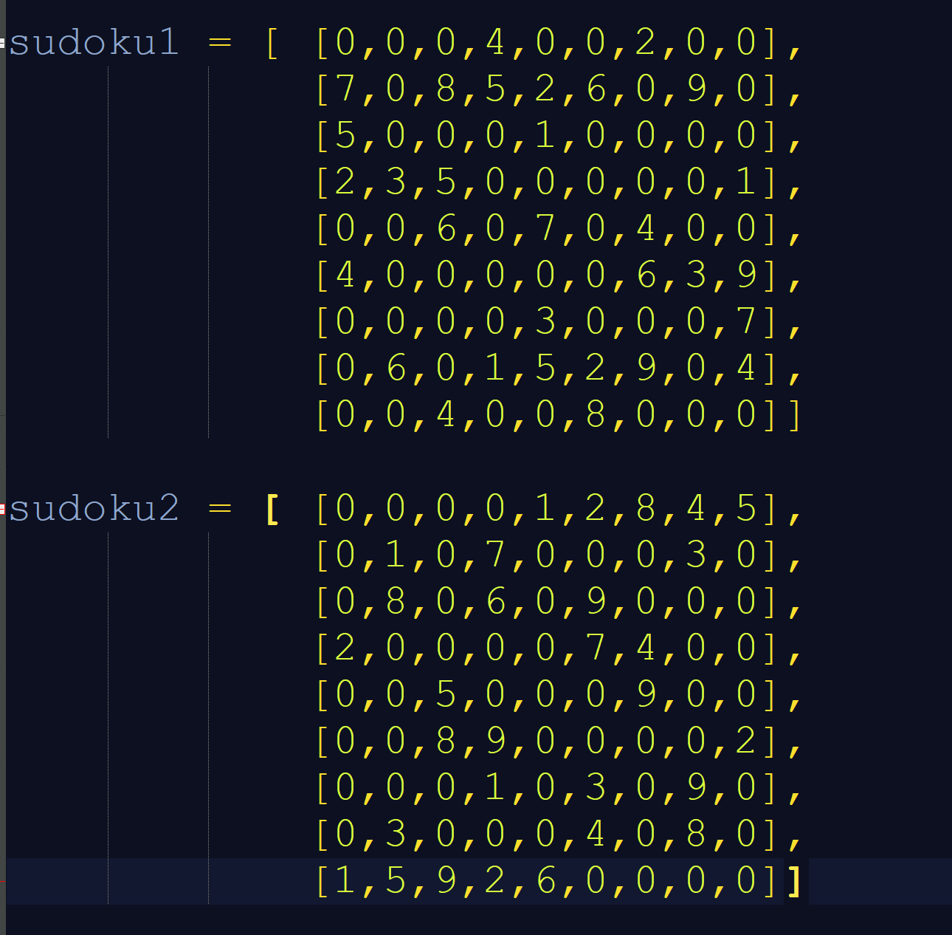
Setup!
Data Structure: 2-D Matrix
Number of Problems: 30 puzzles
0 => Empty Cells
1 to 9 => Already filled Cells
Notes:
As far as our data structure goes, we decided upon a 2D Matrix to contain our Sudoku Puzzles.
We generated 30 Sudoku Puzzles that contain a similar structure pictured here.
Where here in sudoku1 you can see the top row of the first sudoku puzzle, 0-0-0-4-0-0-2-0-0.
Where 0 will represent an empty cell in the sudoku puzzle and the 4 and 2 will represent a filled cell. In their appropriate column based on their place from 1 to 9.

Slide 6
Satisfiability

Slide 7
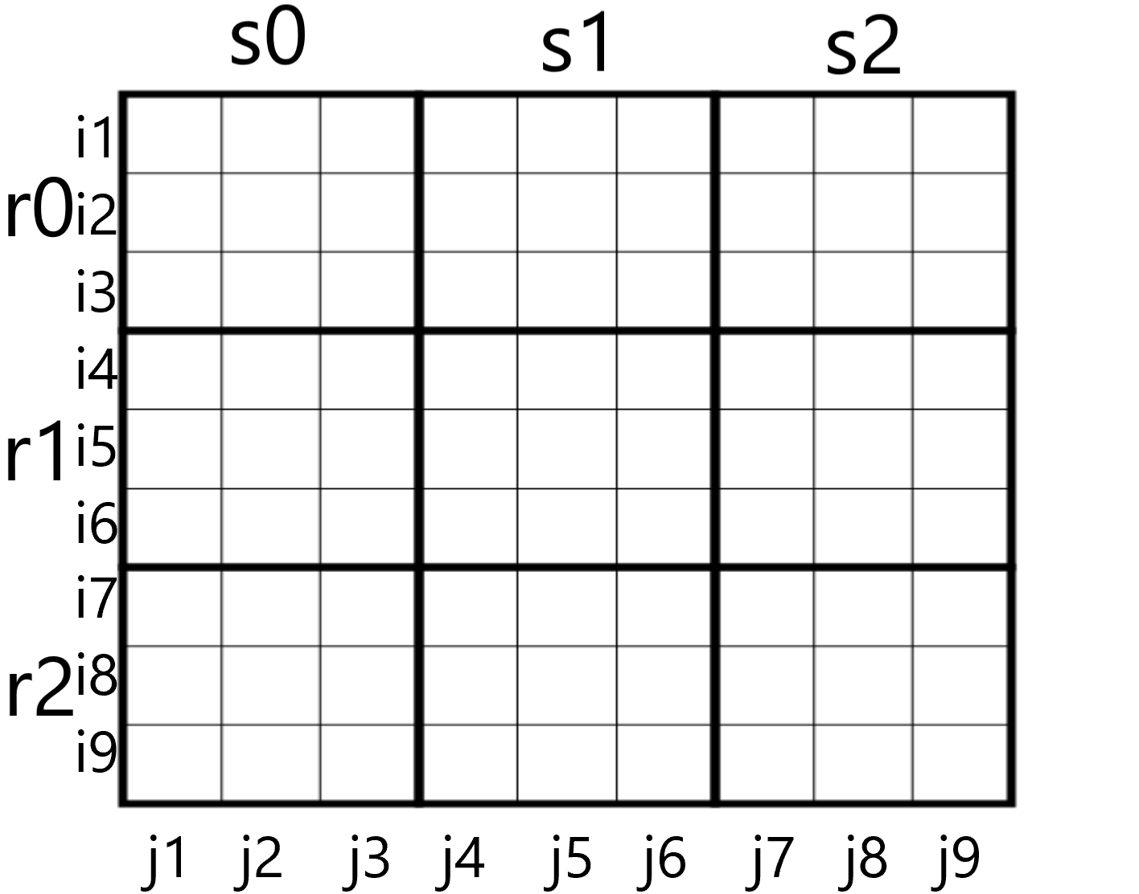
Satisfiability (Constraints)
Let p(i,j,n) denote the proposition that is true when the number n is in the cell in the ith row and the jth column.
There are 9 ×9 × 9 = 729 such propositions.
For each cell with a given value, assert p(i,j,n), when the cell in row i and column j has the given value.
To solve a Sudoku puzzle, we need to find an assignment of truth values to the 729 variables of the form p(i,j,n) that makes the conjunction of the assertions true. These values determine whether a solution to the puzzle is found.

Slide 8
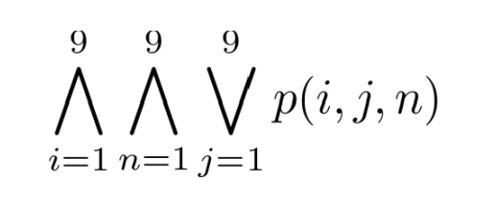
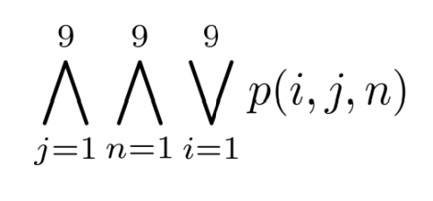
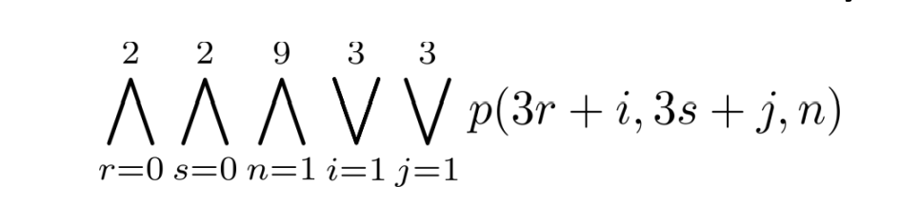
Constrains (Continued)
Assert that every row contains every number.
Assert that every column contains every number
.
Assert that each of the 3 x 3 blocks contain every number.
Assert that no cell contains more than one number.
Notes:
Grid

Slide 9
How it works? (Constraints)
Notes:
Unique, row, colum block

Slide 10
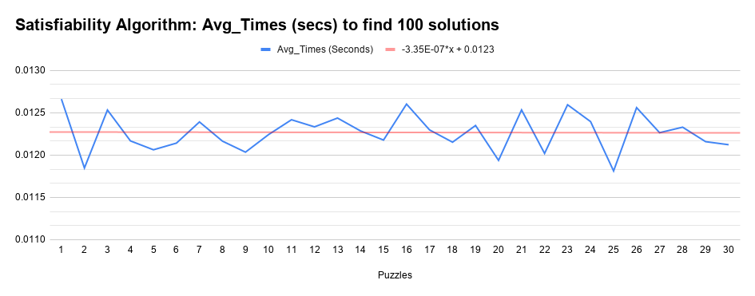
Satisfiability (Analysis)
Notes:
The blue line the average time taken by this algorithm to solve each board. We did 100 iterations to get the average time for each board. The red line indicates the trend of the graph which is pretty linear and constant because we are running a set number of constraints for a set grid size.

Slide 11
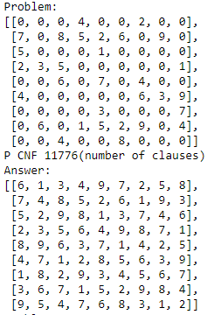
Sample Input & Output (Satisfiability)

Slide 12
Simulated Annealing

Slide 13
Simulated Annealing
Approach
The approach of Simulated Annealing is similar to the heating and cooling of metal being worked in a forge, heating and cooling slowly.
The algorithm acts as a hill climber focusing on random move as long as it improves the solution BUT becomes greedier towards the end
The usage and performance of steps increases or decreases temperature
High temp = worse moves or a higher chance to accept worse solutions
Low temp = Better chance to take good moves and not take worse solutions
Notes:
Similar to heating and cooling of metals, similar to a forge. It has its own heating and cooling schedule allowing for it to be different every time. Acts as a hill climber with a very low requirement for important. Temperature is especially important as it directly affects the algorithms decision making

Slide 14
How It Works
Temperature
Max, Initial Temp
Min, Final Temp
Decay
Energy
Calculated by checking uniqueness of columns and rows
Solution found when Energy == -162
Steps
Iterations allowed
Notes:
In order to create this we did use a Simulated Annealing Python Module where a decay was predetermined as shown.
Talk about maybe using different cooling schedules to improve:
http://www.scielo.org.mx/pdf/cys/v21n3/1405-5546-cys-21-03-00493.pdf
The inputs we manipulated in order to find an efficient solution to the 30 sudoku puzzles were:
Max Temperature or the Initial Temp
Min Temperature or Final Temp
Our Energy was calculated by checking the uniqueness of the values on the sudoku puzzle to ensure no errors on the puzzle
If Energy of a board was able to reach an energy level of -162 before all steps or Min Temp were reached then a solution was found.
Steps was a variable defined by us through testing where we increased the amount of steps to increase the space that could be searched to try and find an energy level of -162
-162 comes from the energy decreasing as a solution is being found
-162 = -((9 x 9) + (9 x 9))
9 unique values in all 9 rows, 9 unique values in all 9 columns

Slide 15
Visual
Visual representation of simulated annealing
How simulated annealing works with finding and using solutions based on temperature
This visual shows an example of simulated annealing and how it searches for solutions
The longer it goes the greedier it becomes

Slide 16
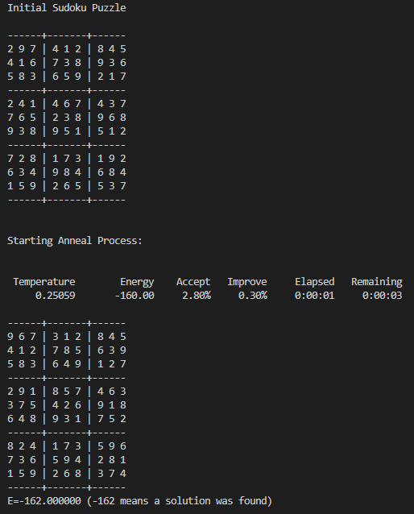
Inputs and Outputs
Our inputs were:
Sudoku Puzzle
Min and Max temperature
Steps to use
Output was:
Puzzle Completion Status
Temperature
Energy
Acceptance
Improve
Elapsed Time
Remaining Time
Notes:
https://github.com/perrygeo/simanneal/blob/master/simanneal/anneal.py
Energy = value of sudoku puzzle
-162 = solution found

Slide 17
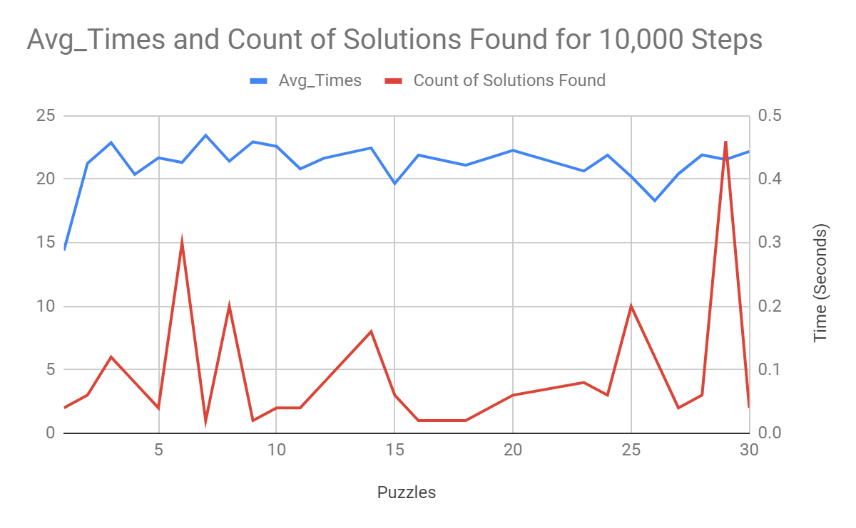
Analysis
Max Temp = 1
Min Temp = 0.50
Steps = 10,000
Notes:
For the following graphs we ran the program for each sudoku puzzle 100 times to get the total number of times a solution was found and it’s average time of completion when the solution was found with varying:
Max Temp,
Min Temp,
And Steps

Slide 18
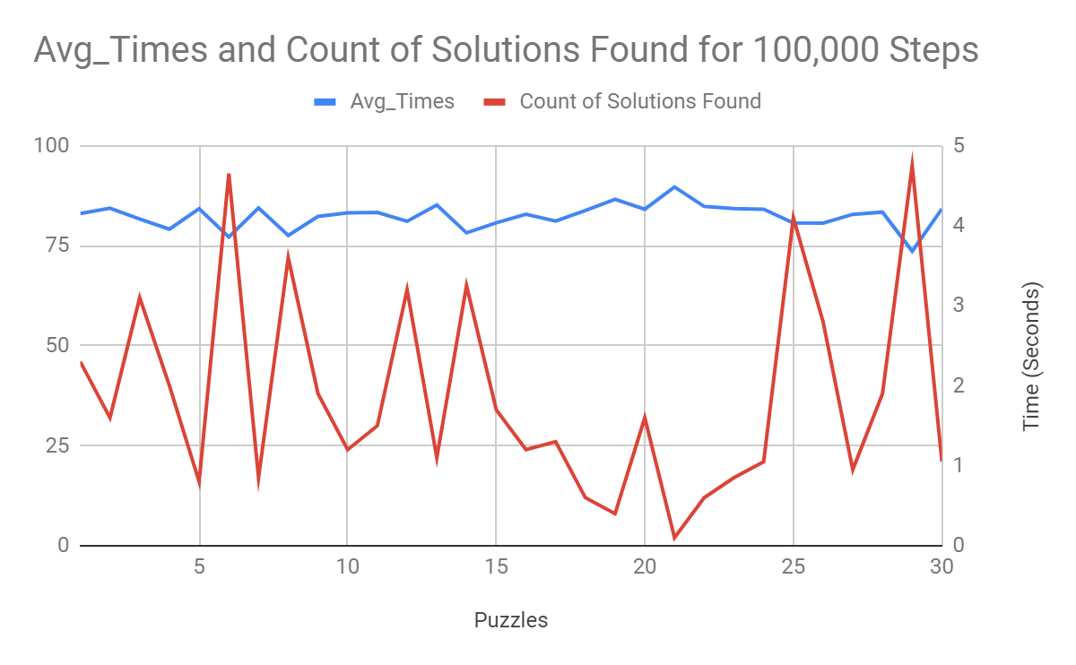
Analysis
Max Temp = 1
Min Temp = 0.50
Steps = 100,000

Slide 19
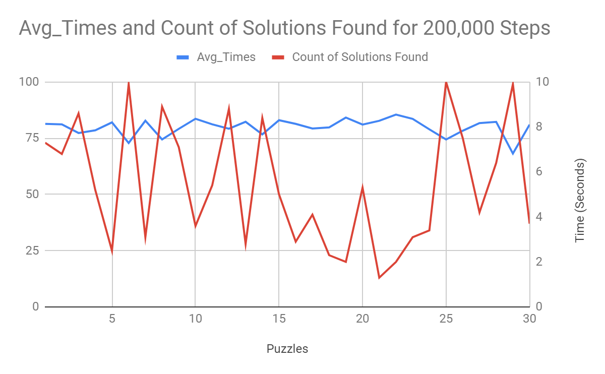
Analysis
Max Temp = 1
Min Temp = 0.5
Steps = 200,000

Slide 20
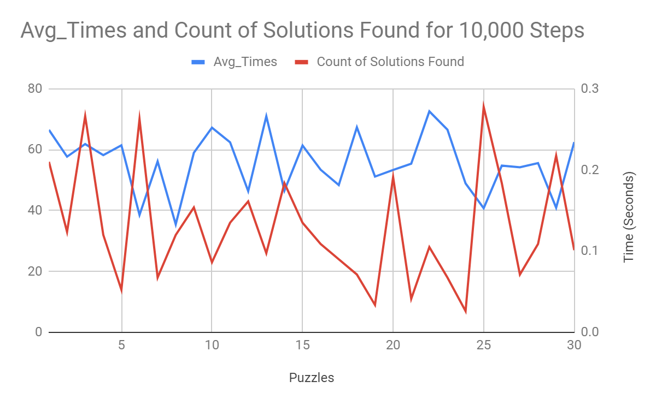
Analysis
Max Temp = .50
Min Temp = 0.05
Steps = 10,000

Slide 21
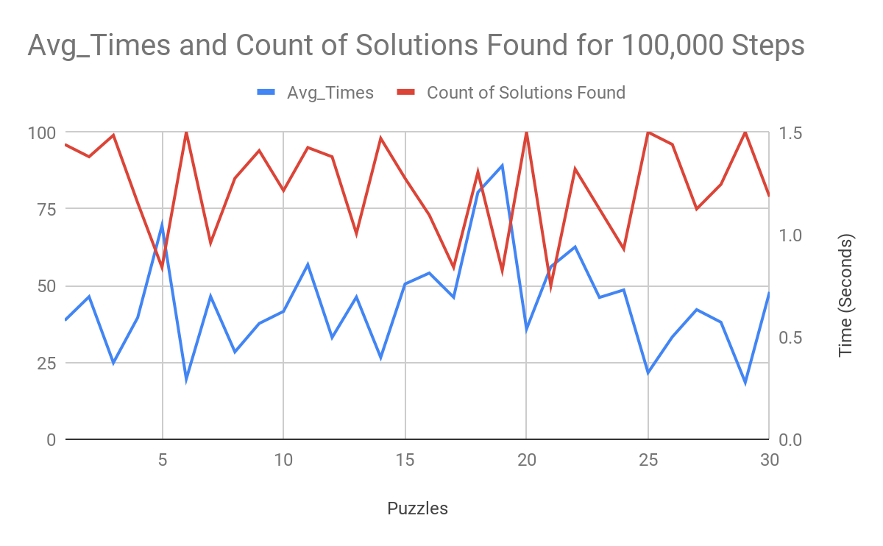
Analysis
Max Temp = .50
Min Temp = 0.05
Steps = 100,000

Slide 22
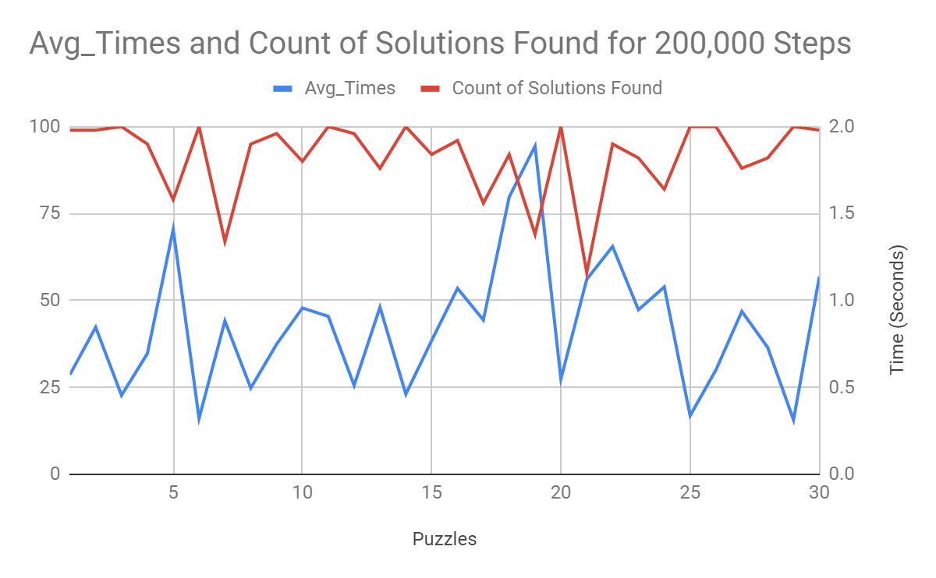
Analysis
Max Temp = .50
Min Temp = 0.05
Steps = 200,000

Slide 23
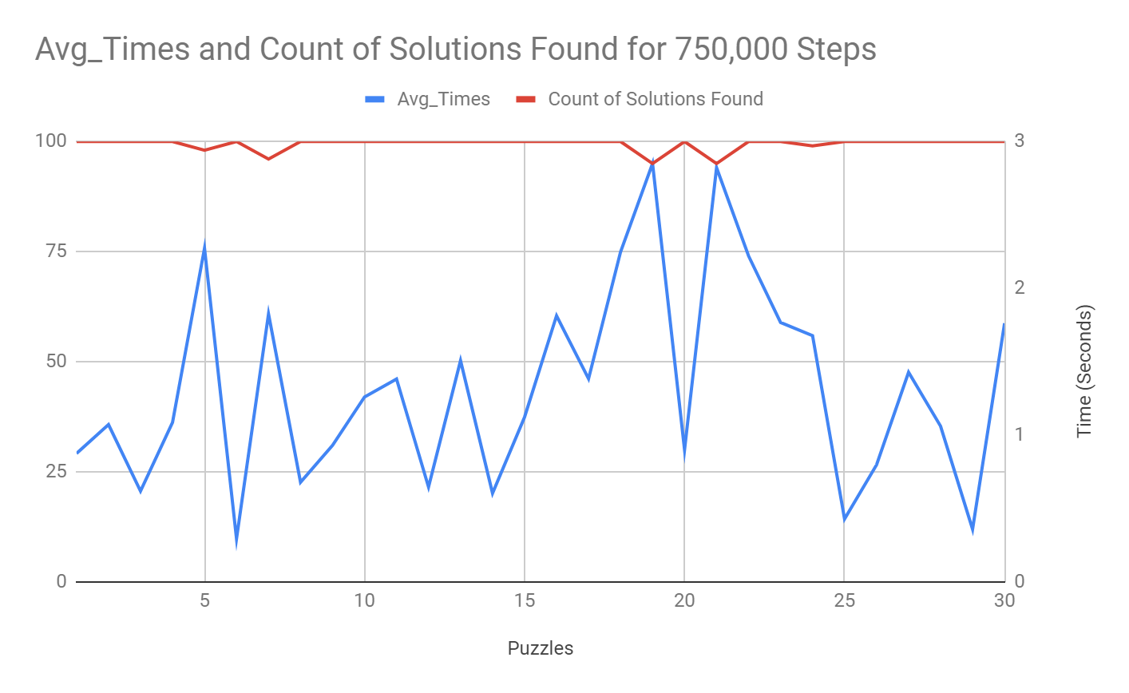
Analysis
Max Temp = 0.50
Min Temp = 0.05
Steps = 750,000

Slide 24
Evolutionary Algorithm
Notes:
Kammy

Slide 25
Evolutionary Algorithm (Approach)
The evolutionary algorithm applied a “natural selection” approach
Inspired by the biology process of genetic mutations and gene combinations during reproduction within a species
The EA performs a continuous cycle of processes until it finds the optimal solution for the sudoku board
Crossovers
Bitwise mutations
Fitness calculations of a population
Notes:
Kammy

Slide 26
Evolutionary Algorithm (Constraints)
Each sudoku board was limited to solve itself within 1000 generations
If no solution was found the algorithm would reset back to generation 0 and repeat the algorithm process
The maximum fitness value was set to 162
Notes:
Kammy Mathematical explanation

Slide 27
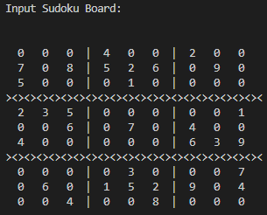
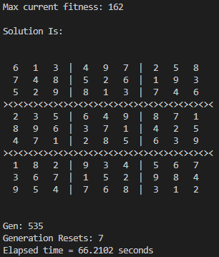
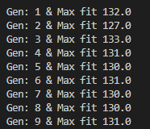
Evolutionary Algorithm (Inputs and Outputs)
Inputs:
Sudoku board number
Outputs:
Completed board solution
Time Elapsed
Max fitness value
Amount of generation resets
Notes:
Kammy

Slide 28
Evolutionary Algorithm (Process)
Start
Initialization
Mutational crossover child initialized
Calculate Fitness
Value not met
End
Value met/Solution found
Notes:
Ryan
Our algorithm is relighent on a cycle of random mutations crossed with a parent population to produce a new population.
It starts by initializing a population of 200 boards.
It then calculates a fitness value for each board in the population, selecting parents for the future generation.
It then checks the fitness value.
If the value is met then the solution is found otherwise it will push the population into a mutational crossover producing the new population.
Reentering the cycle it checks the fitness value again.
The animation on the left is not accurate to the functionality of the algorithm however it reflects the randomness and instant inputs of each cell across each board.

Slide 29
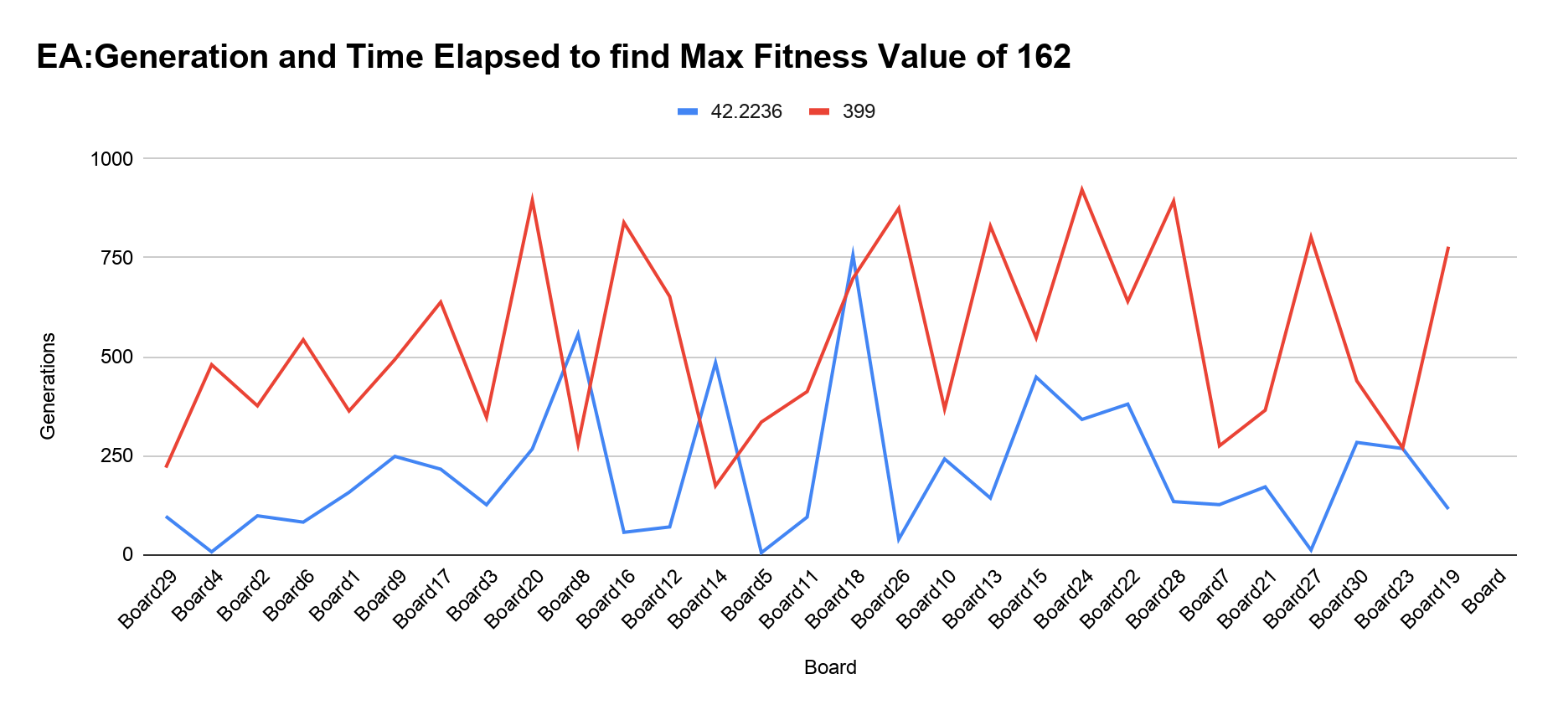
Evolutionary Algorithm (Results)
Notes:
Ryan
Results are random.
This graph shows each board, their generations and the time it took to complete each result
The hardest puzzle with a difficulty rating of .89 with an output of 778 generations and having taken 115 seconds.
Our easiest puzzle has a difficulty rating of .21. The data taken for this 399 generations and 39 seconds.
Puzzle 18 and 5 with ratings of .48 and .47 with times of 756 and 4 seconds and generations of 698 and 335 respectively.
Highest generation of 922 has a time of 341 seconds, and a rating of .52.
Lowest generation of 174 and a time of 484 seconds.

Slide 30
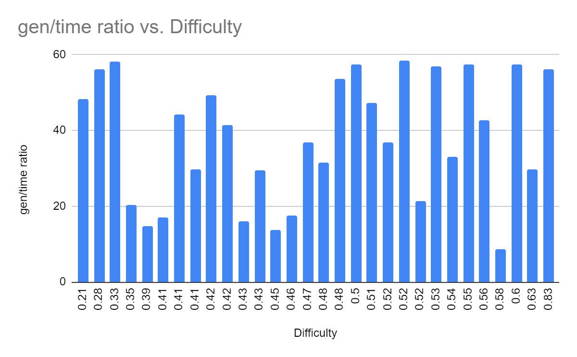
Evolutionary Algorithms (Analysis)
Variable balance IS needed
Greater population = slower generational result
Greater reset value = higher chance of balanced mutation on row
Randomness
No correlation with time vs difficulty
Notes:
Ryan
It is important to know that the variables being used need to be balanced otherwise it will run forever.
The greater the population size produces a slower generational production which drastically increases the time it takes to produce a valid result.
The lower population size reduces the growth towards the ideal fitness, increasing both the time and generations it takes to find a result. This tends to not
The greater the reset value reduces more unwanted mutations, however can also allow loops to continue. The loop is made when values in the unchecked rows are mutated as the crossover occurs. Creating two alternating values
That is why we kill off the population at 1000 generations and initiate a new population based on the inputted board. Not enough generations will result in non-solutions.
There is no correlation with time vs difficulty rating. This is reflected in this graph as generation over time in relation to its difficulty rating.

Slide 31
Comparison and Analysis
Satisfiability simply follows constraints and has a constant time function which makes it the fastest algorithm.
Simulated Annealing, is slower because it becomes a greedy algorithm when it’s closer to the solution.
Evolutionary Algorithm, because of its randomness and the constant generation resets, turns out to be the slowest of the three algorithms.

Slide 32
Contribution
We researched a lot of different algorithms online for this problem and those programs inspired our final code.
We could go into more depth on analysis and even see if something like this has ever been done (if not we could publish it).

Slide 33
Questions

